Slide 1
Module 4: Credit Matters

Slide 2
Welcome & Housekeeping
Introductions
Did everyone sign in?
PRE-Test Evaluation

Slide 3
Agenda
Today we will focus on credit.
We will look at the various ways that our credit profile is used in everyday life.
We will cover credit scores and credit reports, including what makes up a credit score and the benefits of good credit.
Finally, we will examine debt and how we can avoid lending and collection scams.

Slide 4
Activity
We are going to start with a question for the group:
True or False?
A credit score is only important when I borrow money.
Discussion: Tell us why you answered the way you did.

Slide 5
Answer
The answer is False — credit is important for everyone, including people with disabilities, and a credit score is only one part of our credit profile.

Slide 6
Overview, Purpose and Expected Outcomes
Why is credit important?
Why do people with disabilities need credit?
Credit affects your life, in addition to when you borrow money.
How do I establish credit?
Your credit profile: credit report and credit score basics.
What do you do when bill collectors call, or notices come in the mail?

Slide 7
What Is Credit?
Credit: our ability to borrow money now and pay it back later
Our credit profile is created over our lifespan
Credit report — accompanying information
Credit score — point-in-time snapshot

Slide 8
The Four Cs
Financial institutions refer to the four C’s of credit:
Capacity: present and future ability to meet your payments
Capital: value of your assets and net worth
Character: how you have paid your bills in the past
Collateral: property or assets used to secure the loan

Slide 9
Why Does Credit Matter?
Credit is used for a variety of life purposes:
Employment
Insurance policies
Renting apartments
Utilities: water, power, phone/internet
Emergencies
Convenience
Large purchases — cars and homes
Borrowing at a reasonable rate of interest
Purchasing assistive technology

Slide 10
Video
How to Start Building Credit from Scratch

Slide 11
Question #1
Once a bad credit score, always a bad credit score.
True
False

Slide 12
Question #1 (Continued)
The answer is False.
Your credit score is a snapshot of what your credit looks like at that point in time.
Gradually, your score can change based on how you handle credit.

Slide 13
Question #2
A great credit score guarantees that I will be able to get a loan.
True
False

Slide 14
Question #2 (Continued)
The answer is false.
Your credit score is one of the factors lenders use to make credit decisions. Other factors, like income and/or collateral, are also taken into account.

Slide 15
Credit Scores and Credit Reports
What is in a credit report and how is that different from a credit score?
A credit score is a number between 300-850; 720-850 is considered excellent.
FICO stands for Fair Isaac Company, the company that created and computes the FICO credit score.
Although other companies also compute credit scores, FICO is the most used score.
The FICO® Score is calculated from several different pieces of credit data in your credit report. This data is grouped into five categories.
Your FICO Score considers both positive and negative information in your credit report.

Slide 16
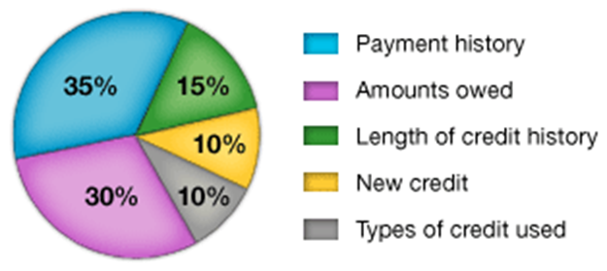
How Is the Score Figured Out?
How a FICO Score is broken down
The percentages in the chart reflect how important each of the categories is in determining how your FICO Score is calculated.

Slide 17
Free Credit Scores
Visit CreditKarma.com for a free credit score.

Slide 18
How to Improve Your Score
Late payments will lower your FICO Score, but establishing or re-establishing a good track record of making payments on time will raise your score.

Slide 19
Credit Reports
Each consumer is entitled to a free copy of their credit report annually.

Slide 20
Question #3 (Continued)
Where can you get a free copy of your credit report one time per year?
a. AnnualCreditReport.com/Index.Action or 1-877-322-8228
b. FreeCreditReport.com
c. CreditKarma: free score and credit report
c. By writing or calling the three credit reporting bureaus: Equifax, Transunion and Experian; with a copy of public benefit, SSI award letter or credit denial letter

Slide 21
Credit Reports (Continued)
The three major national credit bureaus are:
Equifax, 1-866-349-5191 Fraud Hotline: 1-888-766-0008
Experian, 1-877-284-7942 Fraud Hotline: 1-888-397-3742
TransUnion, 1.800.916.8800 Fraud Hotline: 1-800-680-7289

Slide 22
Credit Reports Include
Name and Social Security number
Where you work
Where you live and previous addresses
How you pay your bills
Whether you've been sued, arrested or filed for bankruptcy
Includes collections and judgments
Much more, as you will see with your own report

Slide 23
Different Types of Debt
First and foremost: Make the most of your money and don’t spend too much for your purchase.
You may borrow money. Basic borrowing:
Credit Cards
Consumer Installment Loans
Mortgage Loans
You may choose a smart alternative to borrowing:
Savings
Layaway
90 days same as cash
Avoid the costly alternatives to borrowing
Rent to Own
Buy here/pay here

Slide 24
Revolving Debt
As we discussed in Module 2, credit cards allow you to buy goods or service now and pay back over time. These are “revolving” debts.
Examples: Visa, MasterCard, Discover
Have minimum payments;
Have annual percentage rates/fees/terms;
Allow you to build credit;
Some have rewards;
All “plastic cards” are not credit cards. “Store brand charge cards” have similar features and allow credit-building;
Plastic Debit Cards and Stored Value/Prepaid Cards do not enable credit building;
For FICO scores, keep outstanding balances below 30% of the credit limit.

Slide 25
Installment Debt
Consumer Installment Debt: allows you to purchase goods and services now, and pay back over a fixed number of installments, thus “installment debt.”
Examples: Student loans – 10 years, car loans – five years;
Have the same payment for the life of the loan;
Have a percentage rate, fees, terms;
May have other benefits:
In a FICO score, longer-term installment debt, paid on time will raise your score.
Mortgage Loans: for the purchase of a home/real estate.
Very important in FICO Score and high scores are a requirement for financing.
Banks, credit unions and government lenders rely on credit scoring;
Stable employment and income are often required to attain a mortgage loan.

Slide 26
Smart Alternatives to Borrowing
Savings — emergency funds, vacation, gifts, specific small purchases, ABLE account
Pay yourself first and save automatically at payday
Layaway — specific stores will hold your purchase and enable you to pay for it over time
Holiday purchases
Watch for fees, terms of the agreement and what happens if you don’t meet the terms
90 Days same as cash — ask about terms

Slide 27
Predatory Lending
Costly alternatives to traditional borrowing — frequently cost you much more
Rent to Own — installment purchase with a high interest rate and high fees
Buy here/pay here — often car purchasing; careful of trade-in and repossession arrangements
Predatory loans terms and conditions — critically important; may be regulated by other states

Slide 28
Laws That Protect You
Credit Protections
Credit Card Accountability, Responsibility and Disclosure Act (CCARD Act): prohibits a lender from extending credit to a borrower under the age of 21 unless the borrower can show that he or she can afford to repay the debt or the borrower has a co-signer, along with other protections
Equal Credit Opportunity Act: lender may not discriminate based on factors unrelated to the individual borrower’s creditworthiness

Slide 29
Laws That Protect Your Credit
Credit Protections
Truth in Lending Act: requires lenders to disclose interest rates in terms of an annual percentage rate (APR)

Slide 30
Laws That Protect Your Credit Reporting
Credit Reporting
Fair Credit Reporting Act: Ensure accuracy, fairness and privacy of information filed with credit bureaus.
One-page Summary of Rights

Slide 31
Laws That Protect You in Collections
Debt Collection
Fair Debt Collection Practices Act: protects consumers from predatory and unfair debt collection
Get the latest from the Consumer Financial Protection Bureau.

Slide 32
How To Establish Credit
A Secured Credit Card is a type of credit card that is backed by a savings account used as collateral on the credit available with the card. Money is deposited and held in the account backing the card.
Secured Credit Card Resources:
Credit Builders Alliance: “Pros & Cons of Obtaining a Secured Credit Card as a Credit Building Tool”
Nerd Wallet lists secured credit cards and compares features.

Slide 33
Avoid Scams
Illinois Attorney General (IllinoisAttorneyGeneral.gov) and the Better Business Bureau (bbb.org) has information on the newest consumer scams.
Illinois Attorney General’s Website
Click on Protecting Consumers
Better Business Bureau Website
Click on Get Consumer Help
Scam Alerts

Slide 34
Scam Examples
Erase bad credit or bankruptcies
No one can erase truthful information from credit reports
Fake Debt Collection:
Phone call to a consumer to collect a fake debt
Hints:
Caller requests a payment TODAY!!!
Caller refuses to provide a physical address
Tips:
Do not provide any information or payments — make payments through the normal channels.
Do a Google search of the caller’s phone number
Contact the original lender

Slide 35
File a Complaint
File a complaint if you have been victimized.
Illinois Attorney General IllinoisAttorneyGeneral.gov
Online submission form
Federal Trade Commission
Asks you to categorize your complaint and has an online chat feature
Consumer Financial Protection Bureau
ConsumerFinance.gov/Complaint
Local Law Enforcement

Slide 36
Homework
Order your free credit reports from AnnualCreditReport.com
Check your report for errors
Contact any lenders as necessary

Slide 37
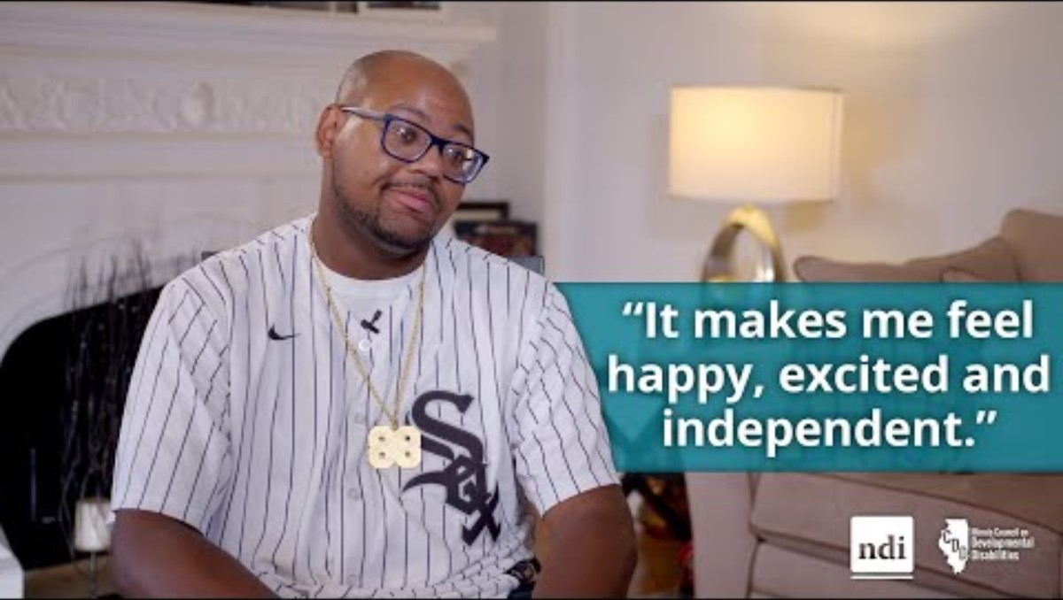
Meet William - from no credit to buying a car on his own

Slide 38
Questions

Slide 39
Evaluation and Closing
Don’t Forget!
Complete and turn in your evaluation and post-test.
Congratulations on completing your first steps towards improving YOUR financial wellness.
Thank YOU!

